Slide 1
Getting Started with ECMAScript
ECMAScript versions and tools
Variables, scope, and strings
Function enhancements
Arrow functions

Slide 2
Section 1: ECMAScript Versions and Tools
Setting the scene
Browser support
Installing Babel
Transpiling ES6++ code
Running ES6++ code
Online JavaScript playground

Slide 3
Setting the Scene
Most JavaScript applications have traditionally been written using "classic" JavaScript
ECMAScript 5 (ES5)
The ECMAScript standard has evolved a lot since then
ES2015, aka ES6 - major changes, e.g. lambdas etc.
ES2016, aka ES7 - async/await etc.
ES2017, aka ES8 - more async/await features etc.
ES2018, aka ES9 - variadic functions etc.
ES2019, aka ES10 - array changes etc.
3

Slide 4
Browser Support
Not all browser support the new features in ES6++
For max portability, you should "transpile" into ES5
Use a transpiler such as Babel or Traceur
We'll use Babel
You can install Babel and related dependencies using Node Package Manager (npm)
You can then use Babel to transpile ES6++ to ES5
See the following slides for details…
4

Slide 5
Installing Babel
Take a look in the C:\JsDeepDive folder
package.json specifies Babel (and related libraries)
You can run npm to install these libraries as follows
Downloads libraries into the node_modules folder
npm install
5

Slide 6
Transpiling ES6++ Code
You can use Babel to transpile code to ES5 syntax, using the Node Package Manager executor (npx)
This example transpiles scratch.js into ES5 syntax, and writes the ES5 syntax to scratchES5.js
npx babel scratch.js -o scratchES5.js
scratch.js
ES6++
scratchES5.js
ES5
let msg = 'Hi'
console.log(msg)
Transpile
"use strict";
var msg = 'Hi';
console.log(msg);
6

Slide 7
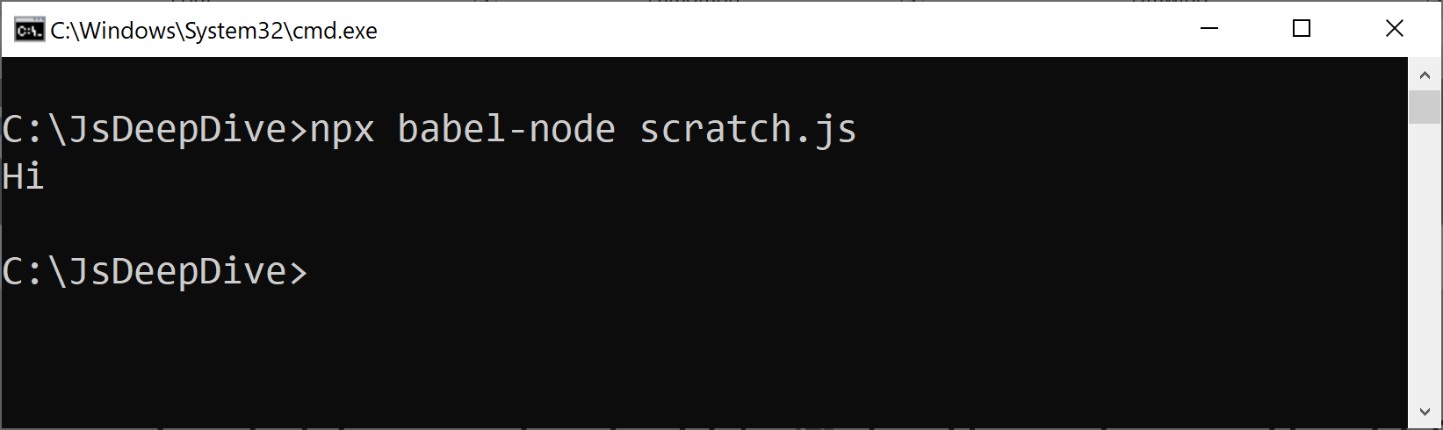
Running ES6++ Code
You can use Babel to run ES6++ code
First it transpiles to ES5 code, then it runs the ES5 code
npx babel-node scratch.js
7

Slide 8
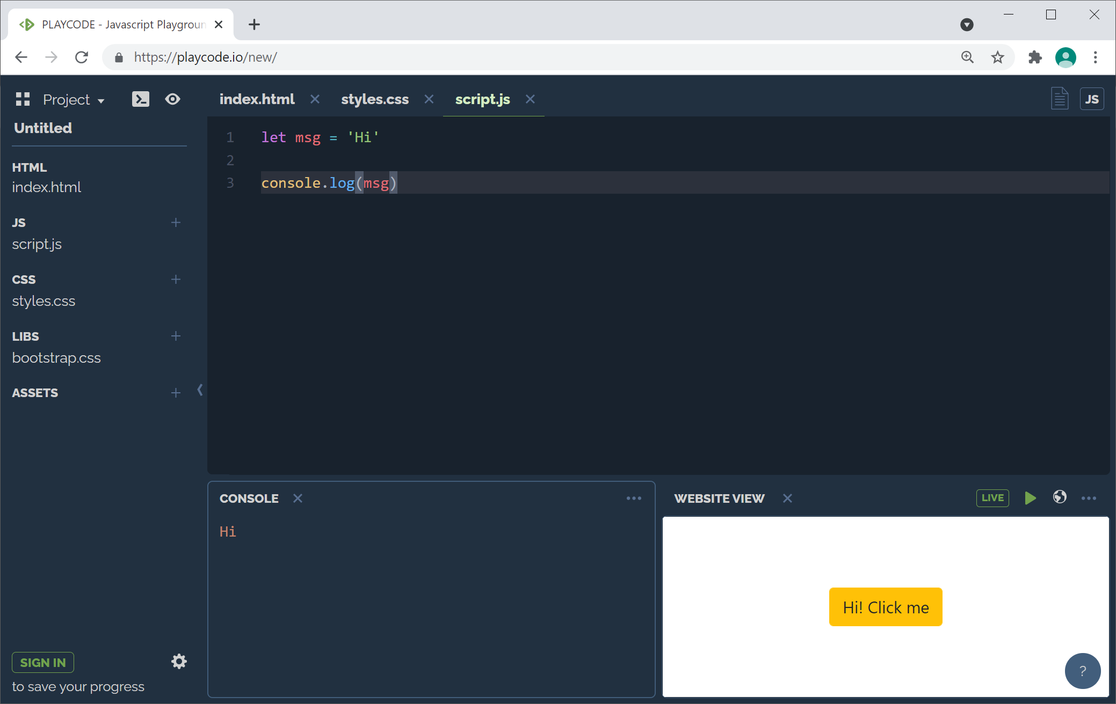
Online JavaScript Playground
There's a handy JavaScript Playground available online
https://playcode.io
8

Slide 9
Section 2: Variables, Scope, and Strings
Variable scope
Constants
String interpolation
Multi-line strings

Slide 10
Variable Scope
ES5 doesn't support block-scoped variables properly
Local variables are hoisted to the top of the function
So they are accessible in the whole function!
ES6++ supports block-scoped variables properly
Use the let keyword rather than var
ES5
if (true) {
var s = "Hi"
}
console.log(s) // Hi
ES6++
if (true) {
let s = "Hi"
}
console.log(s) // Error!
10

Slide 11
Constants
ES6++ supports constants, i.e. immutable variables
Use const keyword and supply a value in declaration
If you use const with an object reference:
The ref is const, not the properties
const PI = 3.14
PI = 99.5 // Error
const obj = {prop: 1}
obj = {prop: 2} // Error
obj.prop = 3 // OK
11

Slide 12
String Interpolation
ES6++ supports string interpolation via template literals
Enclose the string in `back-ticks`
Embed expressions in ${xxx}
let n = 'John'
let a = 21
let html = `<b>${n}</b> will be ${a+1} soon`
console.log(html)
12

Slide 13
Multi-Line Strings
ES6++ supports multi-line strings
Enclose the string in back-ticks
let p = { name: 'Jane', age: 21 }
const personHtml = `
<dl>
<dt>Person info</dt>
<dd>Name: ${p.name}</dd>
<dd>Age next birthday: ${p.age+1}</dd>
</dl>`
console.log(personHtml)
13

Slide 14
Section 3: Function Enhancements
Default parameters
Rest parameters
Spread parameters

Slide 15
Default Parameters (1 of 2)
You can specify default values for parameters
Client code can omit default parameters, and can also skip parameters via undefined
function totalSal(base,bonus1=0.0,bonus2=0.0){
return base + bonus1 + bonus2
}
console.log(totalSal(100))
console.log(totalSal(100,20))
console.log(totalSal(100,undefined,30))
15

Slide 16
Default Parameters (2 of 2)
A default parameter value can use an earlier parameter
A default parameter value can use a global variable
function calcRectArea(width, height=width){
return width * height
}
let defHeight = 5
function calcRectArea(width, height=defHeight){
return width * height
}
16

Slide 17
Rest Parameters
You can define variadic functions via rest parameters
Precede final parameter in the function definition with ...
The parameter values will be accumulated into an array
function list(heading, ...items){
let str = `<h3>${heading}</h3>`
for (let item of items)
str += `${item}<br>`
return str
}
console.log(list('Ducks','Huey','Luey','Duey'))
17

Slide 18
Spread Parameters
You can use ... to expand an array into its values
In this context ... is called the spread operator
let nums = [100, 200, 300]
console.log(...nums)
18

Slide 19
Section 4: Arrow Functions
Introduction to arrow functions
Multi-line arrow functions
Arrow functions and this

Slide 20
Introduction to Arrow Functions
ES6++ supports arrow functions
() encloses params - you can omit () if 1 param
=> separates params from body
The function body is implicitly the return expression
You call an arrow function just like a regular function
let getFullName = (fn,ln) => `${ln}, ${fn}`
console.log(getFullName('John','Smith'))
20

Slide 21
Multi-Line Arrow Functions
You can define an arrow function over multiple lines
Enclose function body in {} braces
Use an explicit return statement to return a value
let getFullName = (fn,ln) => {
let fullName = `${ln.toUpperCase()}, ${fn}`
return fullName
}
21

Slide 22
Arrow Functions and this (1 of 2)
In ES5, nested functions have problems with this
This example copies the name param to this.name
But when setInterval calls the anonymous function, this points to the global window object
function Person(name) {
this.name = name
setInterval(function(){
console.log('Hello ' + this.name)
}, 1000)
}
var p1 = new Person('Janet')
22

Slide 23
Arrow Functions and this (2 of 2)
Arrow functions overcome the this problem
Arrow functions store this in a variable called _this
When you use this in an arrow function, it uses _this
function Person(name) {
this.name = name
setInterval( () => {
console.log('Hello ' + this.name)
}, 1000)
}
var p1 = new Person('John')
23

Slide 24
Summary
ECMAScript versions and tools
Variables, scope, and strings
Function enhancements
Arrow functions

